Slide 1

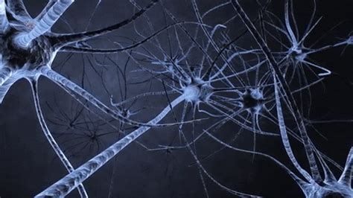
Deep learning
-Fully Connected Neural Networks
Presented by:
Ram Reddy
Maulik Naik
Joanne Jons
Parvati
Abita Ann Augustine
#PyJamming #PoweredByMicrosoft #PoweredByUdacity #sg_agile_squad

Slide 2
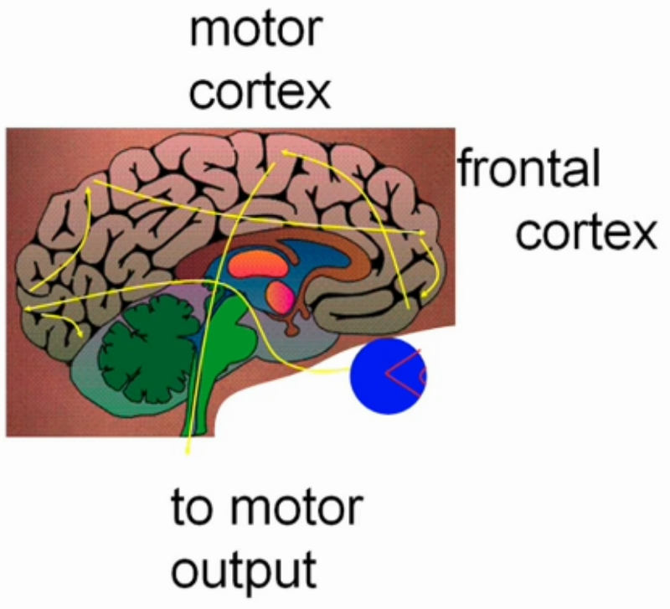
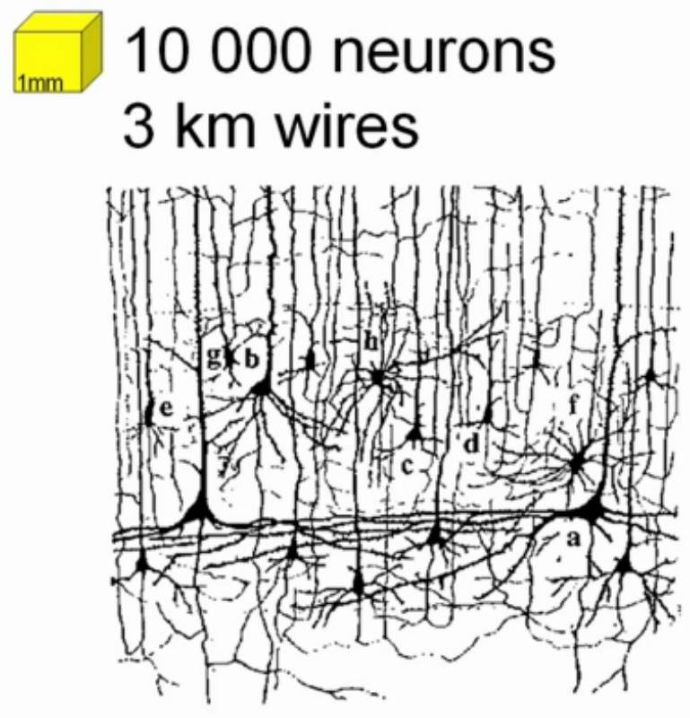
How does human brain work?
source: https://www.edx.org/course/neuronal-dynamics

Slide 3
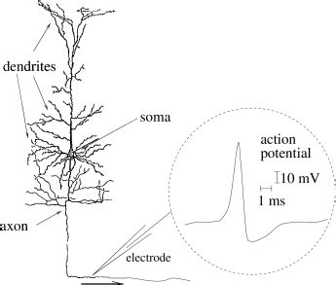
Neuron
source: https://www.edx.org/course/neuronal-dynamics

Slide 4
Learning Mechanisms
Four basic learning rules:
Error-Correction learning
Memory Based Learning
Hebbian learning
Competitive learning
source:https://www.youtube.com/watch?v=O4rU2pImSeo&t=1088s

Slide 5
Different type of Neural Networks
Densely Connected layers
Convolutional Neural Networks
Recurrent Neural Networks
Probabilistic Neural Networks
Deep Belief Networks
Spiking Neural Networks

Slide 6
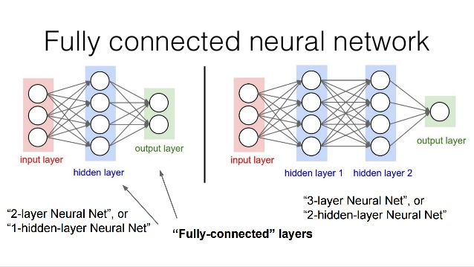
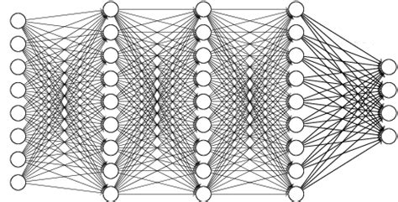
Source : https://math.stackexchange.com/questions/2048722/a-name-for-layered-directed-graph-as-in-a-fully-connected-neural-network
https://www.slideshare.net/lostleaves/deep-learning-behind-prisma-66647472

Slide 7
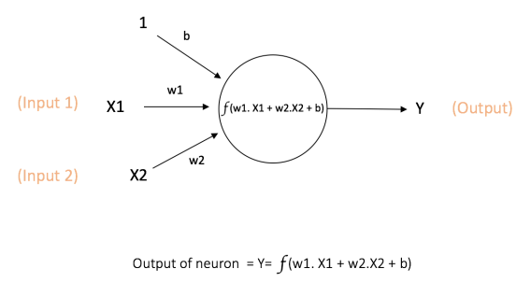
Activation Function
Mathematical equations that determine the output of a neural network.
Normalize the output of each neuron to a range between 1 and 0 or -1 and 1.
Make the work more efficient.
Notes:
https://missinglink.ai/guides/neural-network-concepts/7-types-neural-network-activation-functions-right/#:~:text=Activation%20functions%20are%20mathematical%20equations,relevant%20for%20the%20model's%20prediction.

Slide 8
Need of Activation Function
No activation function => NN is a linear regression
Addition of activation function to neural network executes the non-linear transformation to input
Activation functions are differentiable.

Slide 9
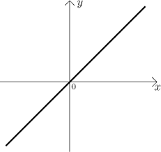
Activation Function
Can be of mainly two types:
Linear Activation Function
Non Linear Activation Function
Examples of Activation Function:
Identity Function
f(x) = x

Slide 10
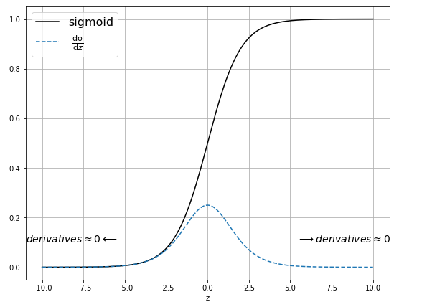
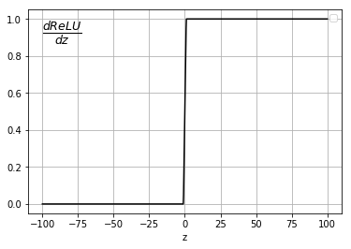
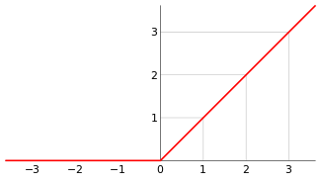
Activation Function
Sigmoid Function
f(x) = 1 / ( 1+e^{-x} )
Ranges from 0 to 1
ReLU( Rectified Linear unit) Function
Ranges from 0 to infinity
Rectifies vanishing gradient problem.
f ( 𝑥 ) = max ( 0,𝑥 )
Notes:
Source: http://media5.datahacker.rs/2018/08/dReLU.png

Slide 11
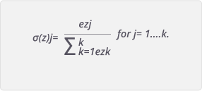
Activation Function
Softmax
Calculates the probabilities distribution of the event over ‘n’ different events i.e. probabilities of each target class over all possible target classes.
Normalizes the outputs for each class between 0 and 1.
Usually used only for the output layer
Notes:
https://yashuseth.blog/2018/02/11/which-activation-function-to-use-in-neural-networks/
https://ml-cheatsheet.readthedocs.io/en/latest/activation_functions.html

Slide 12
Loss Function
Function used to evaluate a candidate solution (i.e. a set of weights) is called objective function.
We try to minimize a objective function in NN.
The objective function that is minimized is referred to as a cost function or a loss function.
Value calculated by the loss function is loss.
They calculate the model error.
Used for parameter estimation
Notes:
https://machinelearningmastery.com/loss-and-loss-functions-for-training-deep-learning-neural-networks/

Slide 13
Examples of Loss Function
Cross-entropy / Log Loss
We try to find set of model weights that minimize the difference between the model’s predicted probability distribution and the distribution of probabilities in the training dataset.
Here the penalty is logarithmic.
For a binary class prediction problem, it is calculated as the average cross entropy across all examples. −(ylog(p)+(1−y)log(1−p))
For multi-class classification, hot encoding of the feature is done and then cross entropy as that of binary class classification. −∑ y_{i}log(p_{i})
M
_{c=1}
Notes:
https://machinelearningmastery.com/loss-and-loss-functions-for-training-deep-learning-neural-networks/

Slide 14
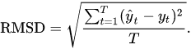
Examples of Loss Function
RMSE / RMSD
To calculate difference between value predicted and actual value.
RMSD is sensitive to outliers.
MSE
Calculated as the average of the squared differences between the predicted and actual values
Result is always positive.
Notes:
https://machinelearningmastery.com/loss-and-loss-functions-for-training-deep-learning-neural-networks/

Slide 15
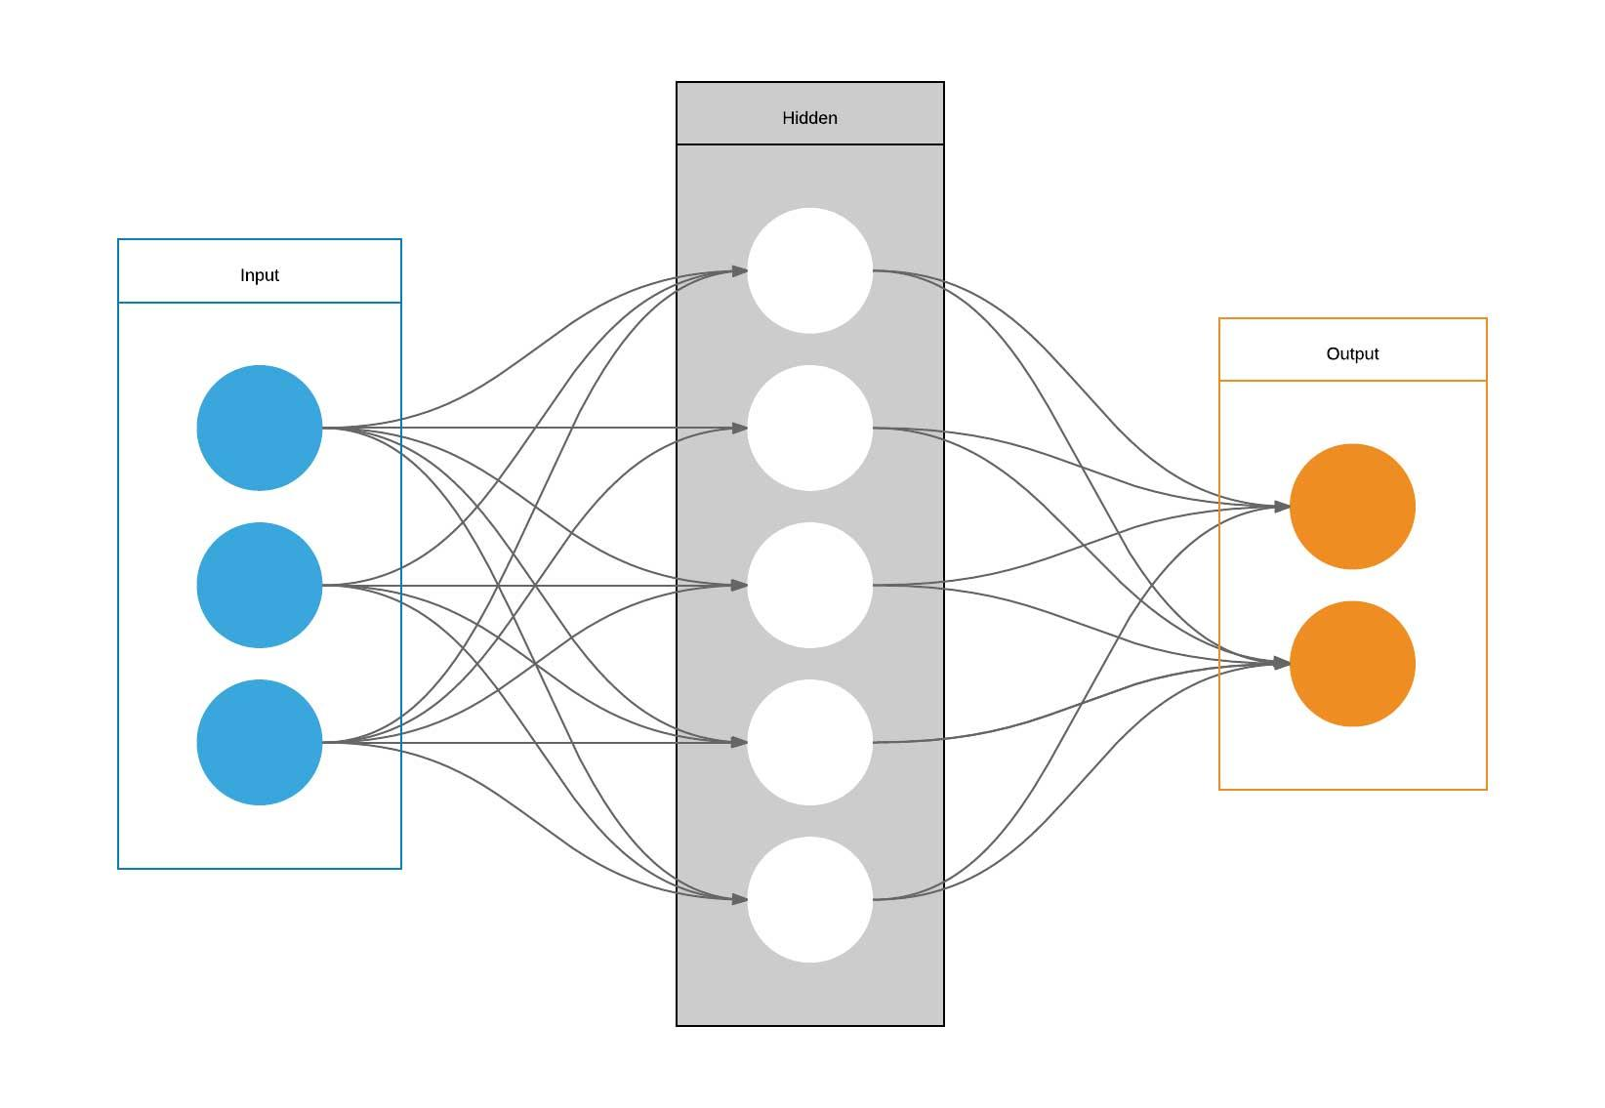
Plan of Attack
Derivative
Partial Derivative
What is a Gradient
Backpropagation using Gradient Descent
Visualize Gradient Descent and Back Prop. @Work
Types of Gradient Descent
#sg_agile_squad

Slide 16
Derivative (Rate of Change)?
LINE
EXPONENTIAL
PARABOLA
y2 - y1
x2 - x1
Y = mx + c
Y = 2^x
Y = 2^x
Constant Rate of Change
Instantaneous Rate of Change
Synchronous to Cost Function (MSE)
#sg_agile_squad
Notes:
Expand the idea from Slope of a Line → Instantaneous Rate of Change at a point on Curve (i.e. Slope of Tangent at that point) → Multidimensional Function (i.e. rate of change in a function with respect to multiple variables)

Slide 17
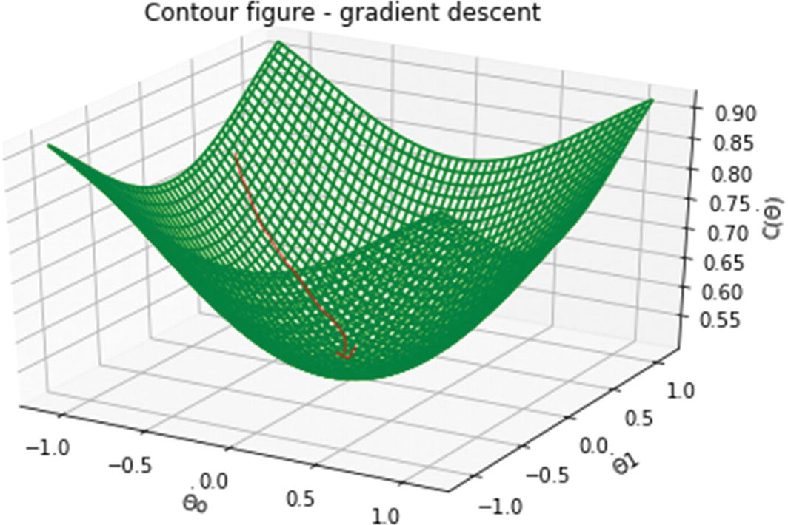
Then, Why do we need Partial Derivative?
In case when a function is dependent on multiple variables, partial derivative helps understand how the function changes as we let just one of those variables change while holding all the others constant. Also called the true impact of variable on the function.
Theta1 Const.
Theta0 Const.
Notes:
Expand the idea from Slope of a Line → Instantaneous Rate of Change at a point on Curve (i.e. Slope of Tangent at that point) → Multidimensional Function (i.e. rate of change in a function with respect to multiple variables)

Slide 18
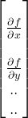
So, What is a Gradient?
In a multi-dimensional paradigm when we have many input variables the target function is often dependent on more than one variable in that case the we come across the term used to express the change in target as a function of change in input variables.
So, Gradient is nothing but a vector of partial derivatives of the function with respect to the input variables. Hence Gradient is a change with respect to all dimension (input variables). Some dimension might contribute more to the Gradient and some relatively less.
#sg_agile_squad

Slide 19
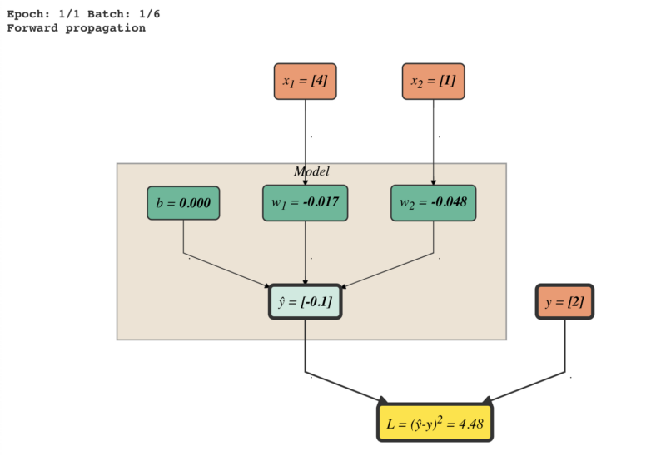
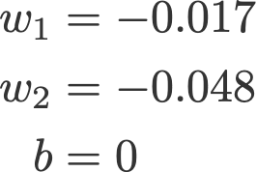
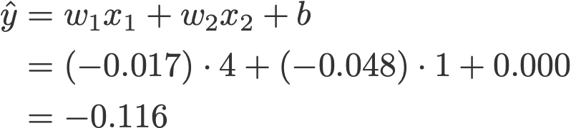
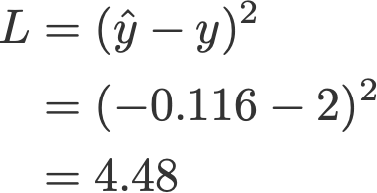
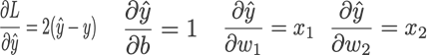
Back Propagation using Gradient Descent
#sg_agile_squad
Notes:
https://makerspace.aisingapore.org/2019/04/tutorial-linear-regression-with-stochastic-gradient-descent/

Slide 20
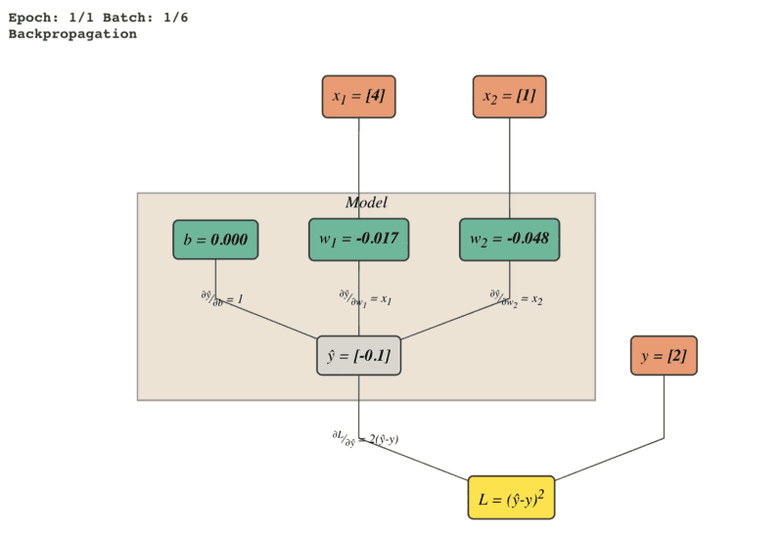
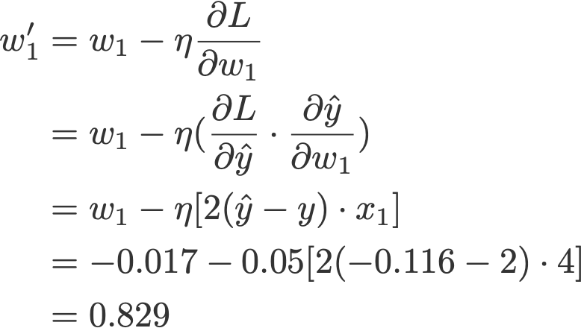
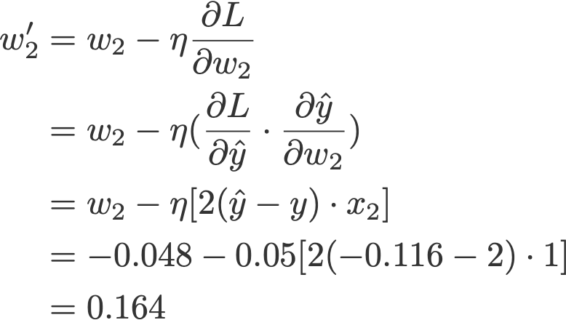
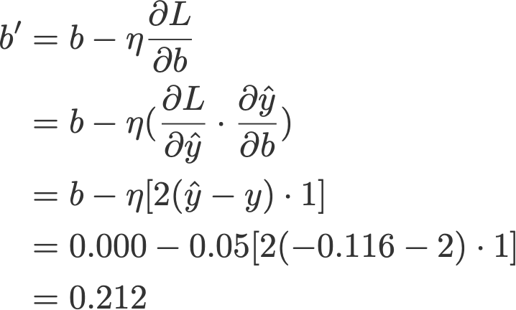
Mathematical Walkthrough of Back Prop.
#sg_agile_squad

Slide 21
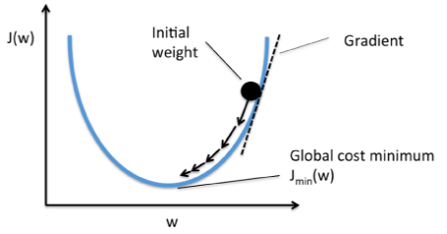
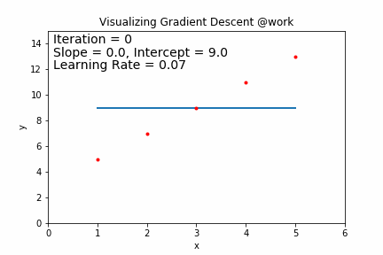
Visualize Gradient Descent and Back Prop. @Work
#sg_agile_squad

Slide 22
Types Of Gradient Descent
BATCH GRADIENT DESCENT
In this type of gradient descent, all the training examples are processed for each iteration of gradient descent. It gets computationally expensive if the number of training examples is large.
STOCHASTIC GRADIENT DESCENT
In Stochastic Gradient Descent (SGD) samples are selected at random for each iteration instead of selecting the entire data set, however, Stochastic Gradient Descent uses only a single sample, i.e., a batch size of one, to perform each iteration. The sample is randomly shuffled and selected for performing the iteration. The parameters are updated even after one iteration. Thus, it gets faster than batch gradient descent.
#sg_agile_squad
Notes:
https://www.knowledgehut.com/blog/data-science/gradient-descent-in-machine-learning

Slide 23
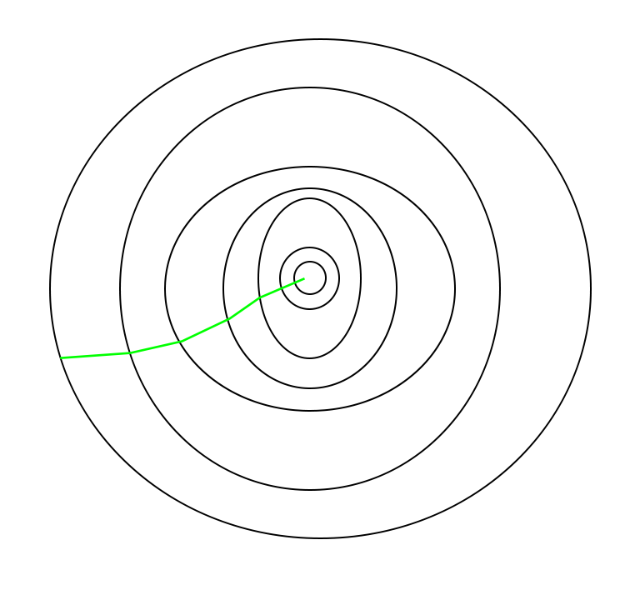
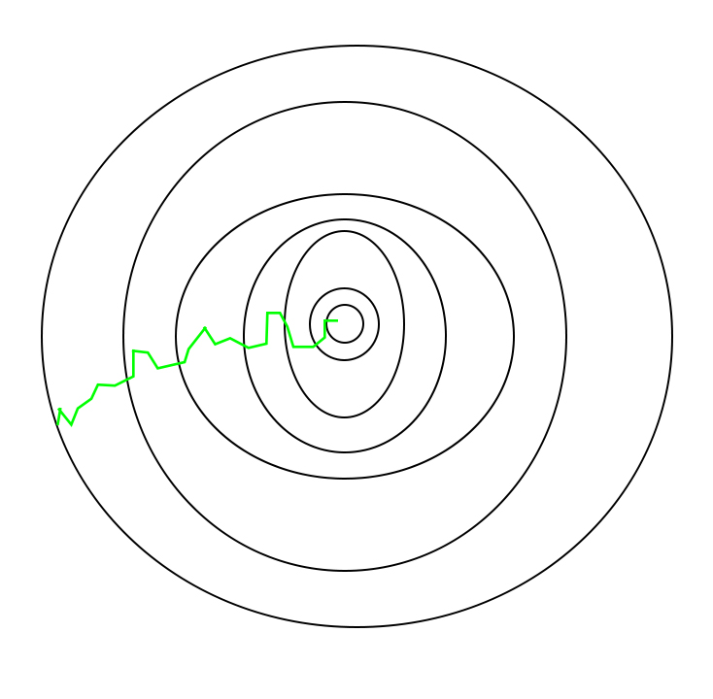
Types Of Gradient Descent (Conti..)
PATH TAKEN BY BATCH GRAD.
PATH TAKEN BY SGD
MINI BATCH GRADIENT DESCENT
This type of gradient descent is considered to be faster than both batch gradient descent and stochastic gradient descent. Even if the number of training examples is large, it processes it in batches in one go. Also, the number of iterations are lesser in spite of working with larger training samples.
#sg_agile_squad
Notes:
https://www.geeksforgeeks.org/ml-stochastic-gradient-descent-sgd/

Slide 24

Issues with Gradient Descent
The resultant loss function might not look a nice bowl, with only one minima we can converge to. Especially, due to lot of non-linear activation used during training NN. The loss function of NN are hardly convex and may look like below:
Local Minima - In the image seen, there exists a local minima where the gradient is zero. However, we know that they are not the lowest loss we can achieve, which is the point corresponding to the global minima. Now, if you initialize your weights at point A, then you're gonna converge to the local minima, and there's no way gradient descent will get you out of there, once you converge to the local minima.
Saddle Points - A saddle point gets it's name from the saddle of a horse with which it resembles. While it's a minima in one direction (x), it's a local maxima in another direction, and if the contour is flatter towards the x direction, GD would keep oscillating to and fro in the y - direction, and give us the illusion that we have converged to a minima.
#sg_agile_squad
Notes:
https://blog.paperspace.com/intro-to-optimization-in-deep-learning-gradient-descent/

Slide 25
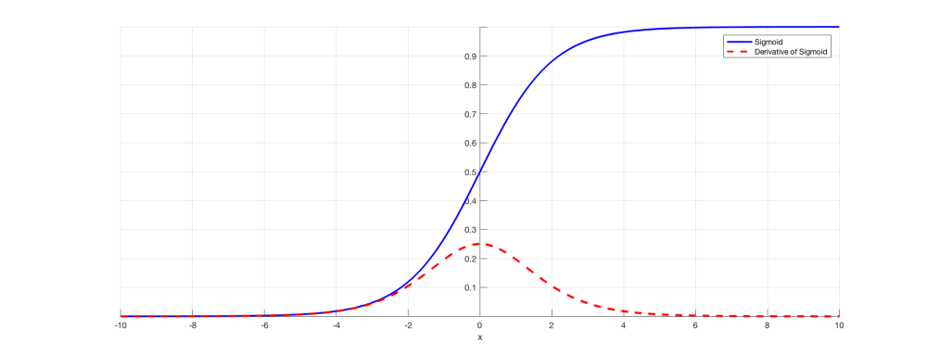
Exploding & Vanishing Gradient
When training a deep neural network with gradient descent based learning and backpropagation, we find the partial derivatives by traversing the network from the final layer to the initial layer
Exploding Gradient :If derivatives are too large, then the gradient will increase as we propagate down the model until they eventually explode.
Vanishing Gradient : If derivatives are small then the gradient will decrease until it eventually vanishes.
#sg_agile_squad

Slide 26
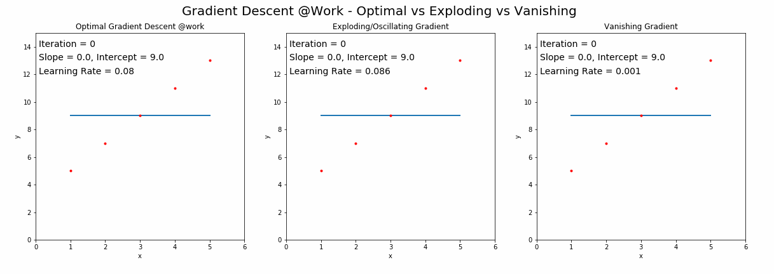
Visualisation of Exploding & Vanishing Gradient
Animation created by @Maulik Naik
#sg_agile_squad

Slide 27
Solving Approaches
Reducing the Number of Layers - this reduces the complexity of our models, hence can be used for both exploding and vanishing gradient problem
Gradient Clipping - used to limit the size of gradients, hence solves exploding gradient problem
Weight Initialization - used to solve both vanishing & exploding gradient problem partially
#sg_agile_squad

Slide 28
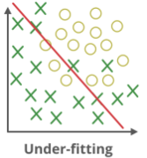
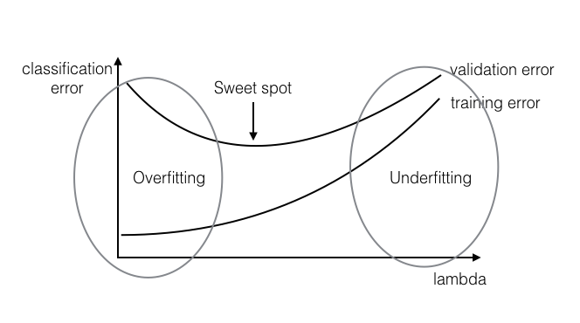
Underfitting in Neural Networks
Model has failed to sufficiently learn the problem and performs poorly on the training dataset and does not perform well with new data either.
High bias and low variance.
Underfitting happens when the model is too simple (too few features or over-regularization)
Some approaches to preventing underfitting are adding neuron layers or input parameters, adding training samples, Improving quality of training samples and decreasing regularization parameters.
#sg_agile_squad
Notes:
https://www.geeksforgeeks.org/underfitting-and-overfitting-in-machine-learning/ https://towardsdatascience.com/underfitting-and-overfitting-in-machine-learning-and-how-to-deal-with-it-6fe4a8a49dbf

Slide 29
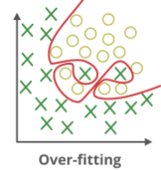
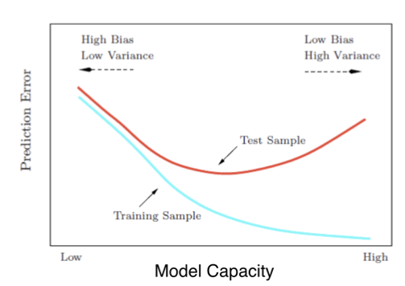
Overfitting in Neural Networks
Model has learned the data ‘too well’, ie, performs well with training data, but does not perform well with new Data.
Low bias and high variance.
Overfitting happens when the model is too complex with too many parameters.
Some approaches to prevent overfitting are early stopping, dropouts, data augmentation and regularization.
#sg_agile_squad
Notes:
https://towardsdatascience.com/preventing-deep-neural-network-from-overfitting-953458db800a https://www.kdnuggets.com/2019/12/5-techniques-prevent-overfitting-neural-networks.html

Slide 30
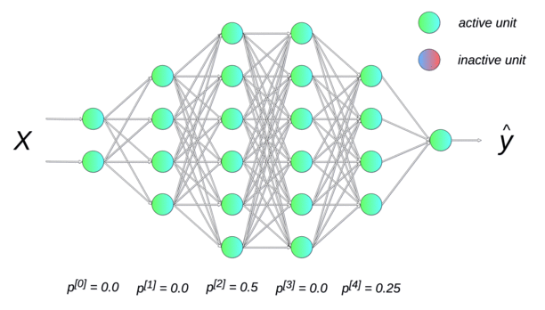
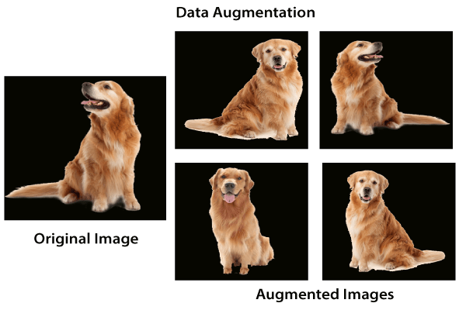
Using Dropout
Data Augmentation
Modifies the network by randomly dropping neurons from neural network during training in each iteration. Dropout Rate (p) is the probability of neurons excluded in each layer.
Improves the performance of the model by augmenting the data that already exists.
#sg_agile_squad
Notes:
https://www.kdnuggets.com/2019/12/5-techniques-prevent-overfitting-neural-networks.html https://towardsdatascience.com/preventing-deep-neural-network-from-overfitting-953458db800a

Slide 31
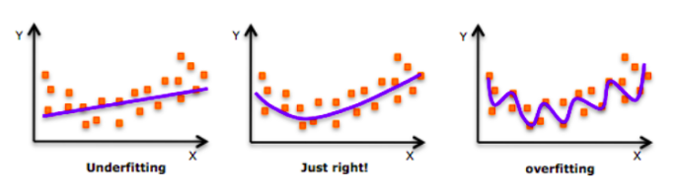
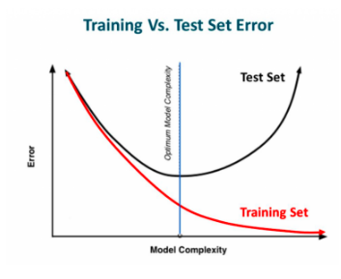
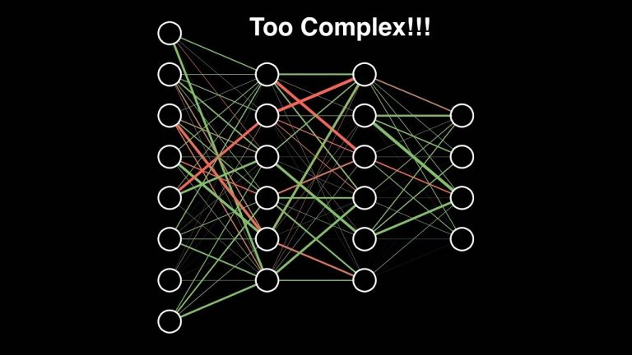
Regularization
One of the common problem a data science professional face is Overfitting.
Regularization is a technique which makes slight modifications to the learning algorithm such that the model generalizes better. This in turn improves the model’s performance on the unseen data as well.
L1 regularization
L2 regularization
Reference: https://www.analyticsvidhya.com/blog/2018/04/fundamentals-deep-learning-regularization-techniques/

Slide 32
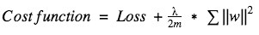
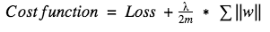
L2 Regularization
Cost function = Loss function + Regularization term
L1 Regularization
The L1 regularization zeroes out many pre-features weight.
The L2 regularization results in plenty of relatively small but non-zero ones.
The key difference between these techniques is that L1 shrinks the less important feature’s coefficient to zero thus, removing some features altogether. So, this works well for feature selection in case we have a huge number of features.
Reference: https://www.analyticsvidhya.com/blog/2018/04/fundamentals-deep-learning-regularization-techniques/

Slide 33
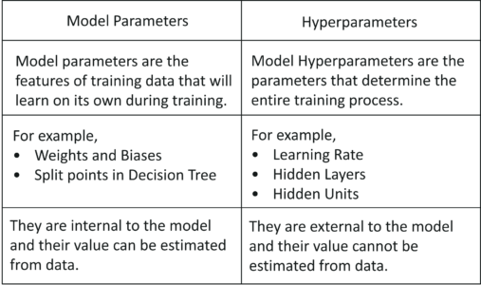
Hyperparameter Tuning
“Process of choosing a set of optimal hyperparameters for a learning algorithm”
Manual search
Grid search
Random search
Bayesian model-based optimization
Reference: https://www.edureka.co/blog/interview-questions/artificial-intelligence-interview-questions/

Slide 34
Manual search
When using Manual search, we choose some model hyperparameters based on our judgement/experience. We then train the model, evaluate its accuracy and start the process again. This loop is repeated until a satisfactory accuracy is scored.

Slide 35
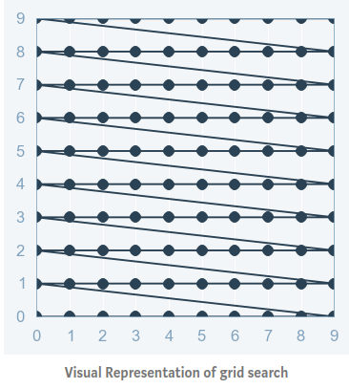
Grid search
Good choice for 2-3 parameters.
For evaluate the parameters over a set of values.
It will try all combination of values.
We choose the combination which has least error.
.
Disadvantages:
Time complexity
Dive deeper
Doesn’t depend on the previous values.
Reference: https://towardsdatascience.com/a-conceptual-explanation-of-bayesian-model-based-hyperparameter-optimization-for-machine-learning-b8172278050f

Slide 36
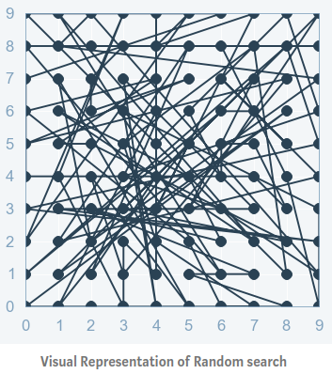
Random search
Works better than grid search.
Randomly selects the combination parameters.
It is good at testing a wide range of values.
Reaches a very good combination very fast.
Randomly samples the search space and evaluates sets from a specified probability distribution.
Disadvantages:
Each new guess is independent of previous one.
It doesn’t give guarantee that the obtained parameter combination is the best.
Reference: https://towardsdatascience.com/a-conceptual-explanation-of-bayesian-model-based-hyperparameter-optimization-for-machine-learning-b8172278050f

Slide 37
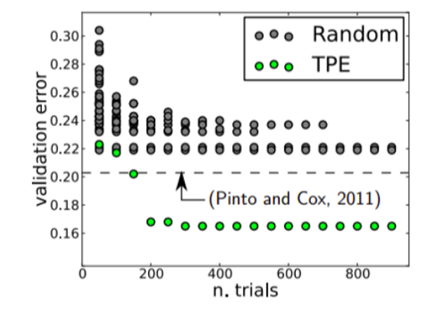
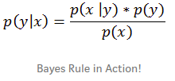
Bayesian model-based optimization
Number of trials are comparatively less.
Uses bayesian optimization algorithm.
Keeps track of past evaluation results.
Builds the probabilistic model of objective function called surrogate function.
These powerful techniques can be implemented easily in python libraries like Hyperopt.
Spends more time in choosing the next values
Reference: https://towardsdatascience.com/a-conceptual-explanation-of-bayesian-model-based-hyperparameter-optimization-for-machine-learning-b8172278050f

Slide 38
Thank You

Slide 39
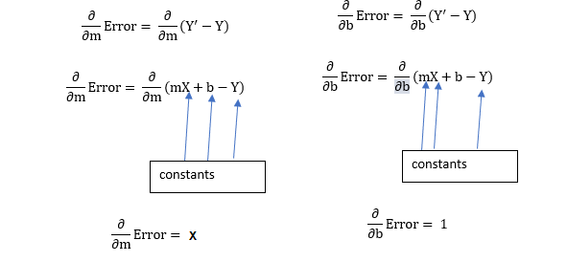
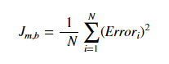
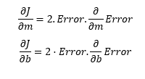
How Gradient Descent Works?
Additional Material
#sg_agile_squad
Notes:
https://towardsdatascience.com/understanding-the-mathematics-behind-gradient-descent-dde5dc9be06e

Slide 40



How Gradient Descent Works?
Additional Material
#sg_agile_squad

